Slide 1
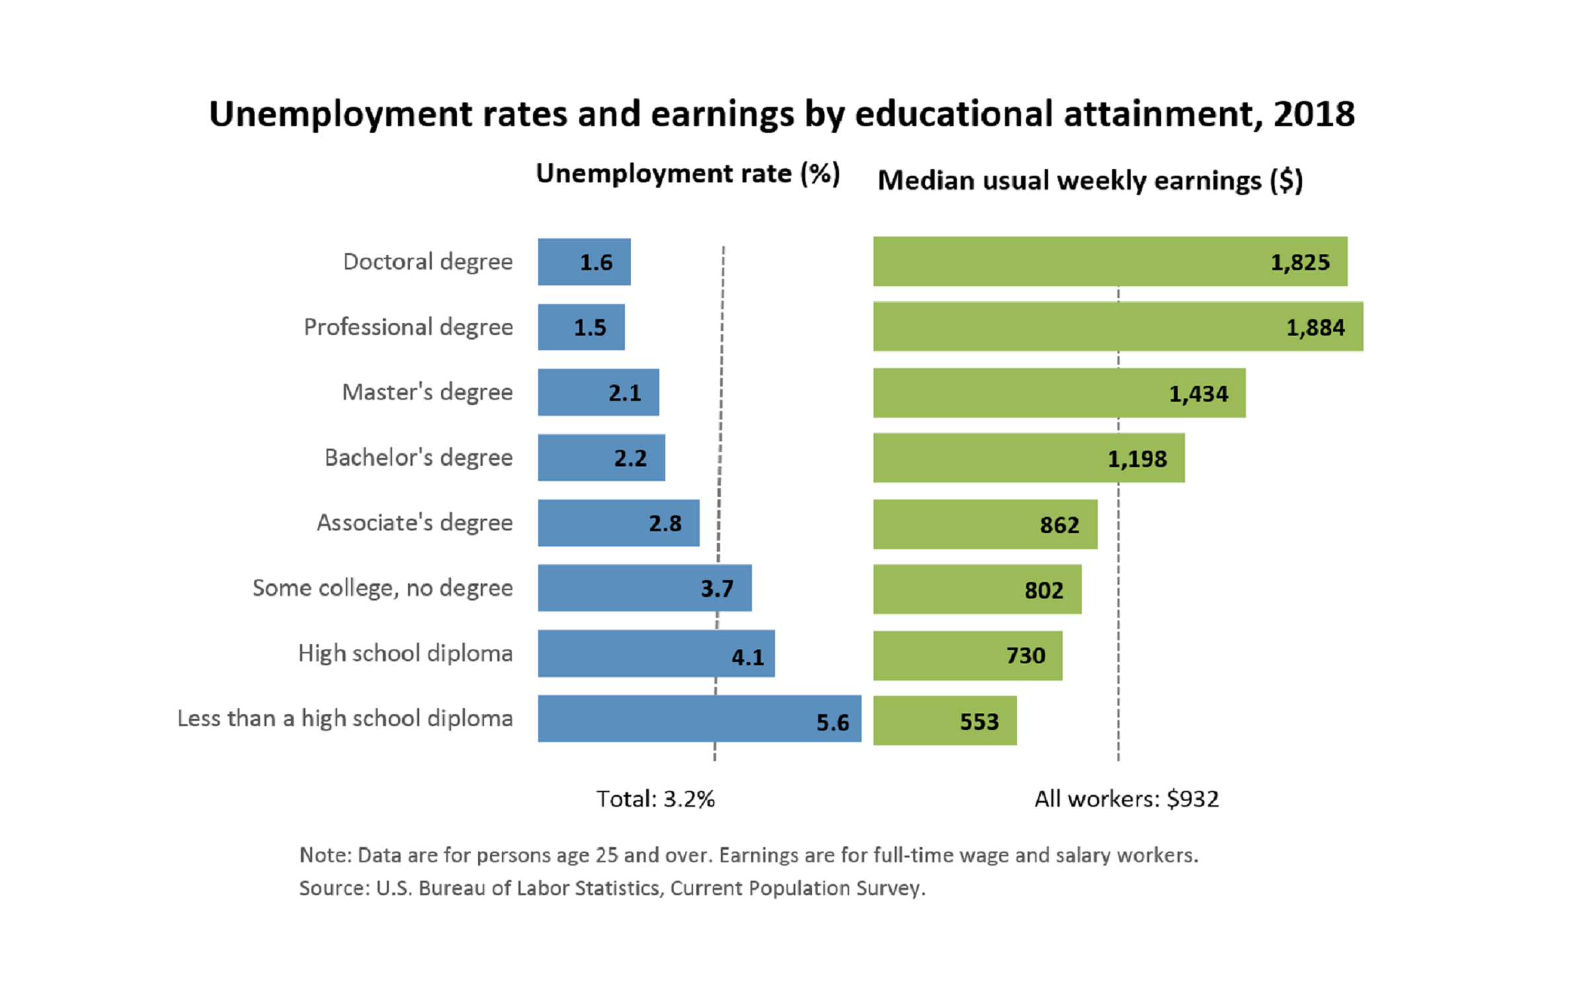
(Bureau of Labor Statistics, 2018)

